Slide 1
Capstone project
TMBD Movie Data Analysis
DIVYANSH KUMAR GUPTA
MENTOR- SHRUTI GODE

Slide 2
Business Objective
Through data analysis, we aim to determine the genres that consistently perform well in theaters, enabling the company to predict the potential commercial success of a movie. This includes understanding audience preferences, predicting high ratings, and optimizing decision-making for content creation and distribution strategies.

Slide 3
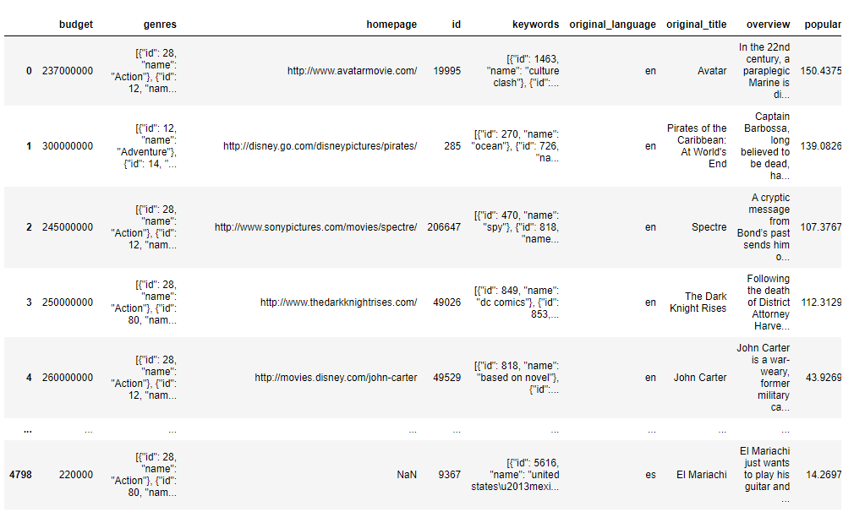
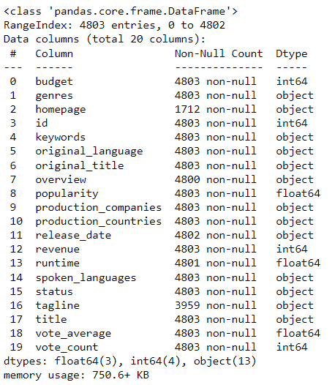
Dataset
Data Collection & Understanding

Slide 4

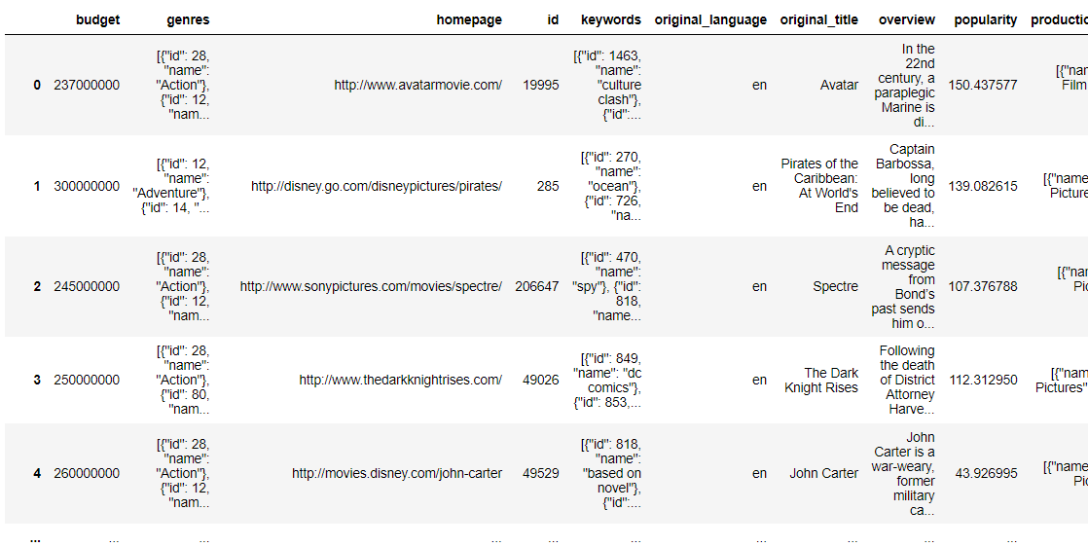
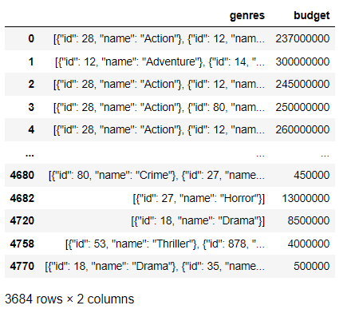
The Movie Categories With A Budget Greater Than $220,000.
Interpretation: The visual shows that genres like ‘Action’, ‘ Adventure’, ‘Horror’ etc have the movies with a total budget greater that $220,000

Slide 5
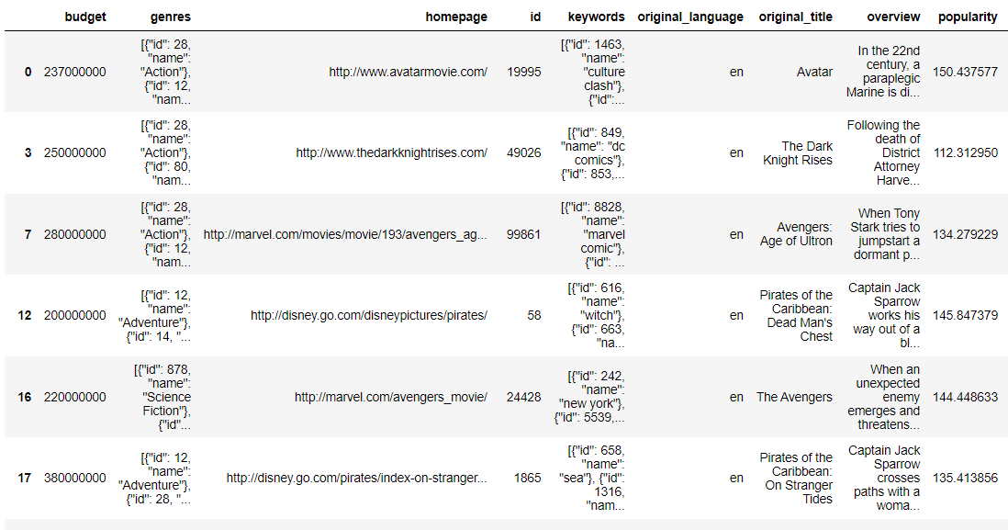
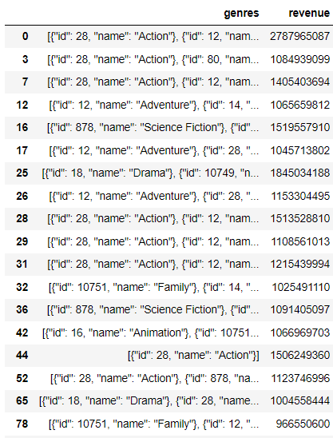
The Movie categories With The Revenue Greater Than $961,000,000
Interpretation: The visual shows that genres like ‘Action’, ‘Science’, ‘Science fiction’ has been a success and made a total revenue greater than $ 961,000,000

Slide 6


Data Cleaning
Before dropping the rows with‘0’
After dropping the rows with ‘0’
Interpretation: The rows with ‘Budget’ or ‘Revenue’ has ‘0’ present in it which is been removed from the dataset for further analysis.

Slide 7
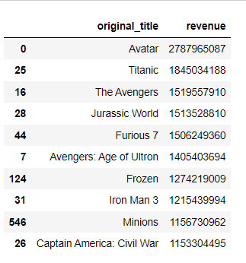
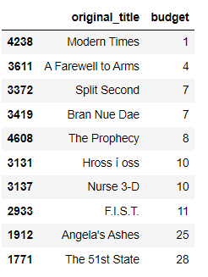
Top 10 movies with highest revenues and Top 10 movies with the least budget.
Top 10 movies with highest revenue
Top 10 movies with lowest budget
Interpretation: ‘Avatar’ has made the highest revenue of $2,787,965,087 and ‘Modern Times is the movie with lowest budget

Slide 8
Is there any correlation between ‘Budget’ & ‘Popularity’ ?
Interpretation: The correlation is close to 0, which concludes that there is a weak or no linear relationship between movie budget and popularity.

Slide 9
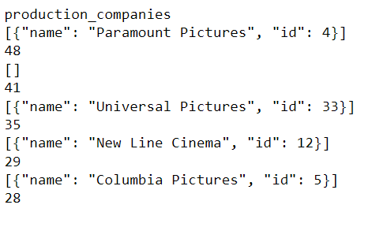
Production Companies Along With The Number Of Times They Appear In The Dataset.
Interpretation: Production houses named ‘Paramount pictures’ has made 48 movies, ‘Universal Pictures’ with 33 movies, ’New Line Cinema’ with 29 movies.

Slide 10
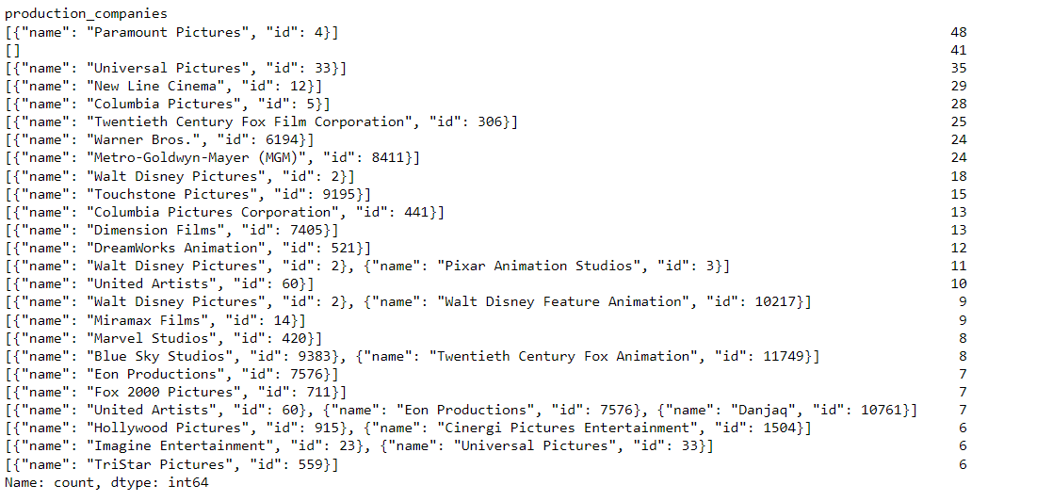
Top 25 Production Companies Based On The Number Of Movies they Have Produced
Interpretation: Production house names ‘Paramount Pictures’ has made the highest number of movies i.e, 48

Slide 11
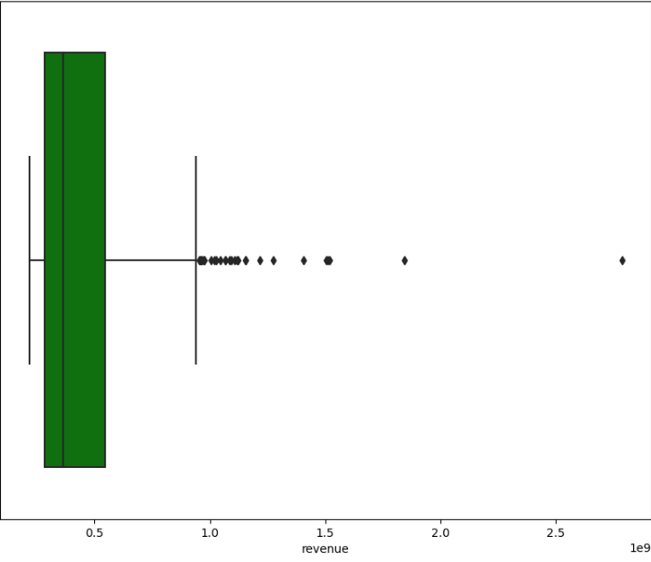
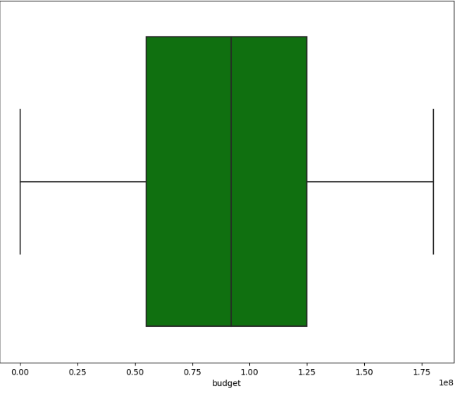
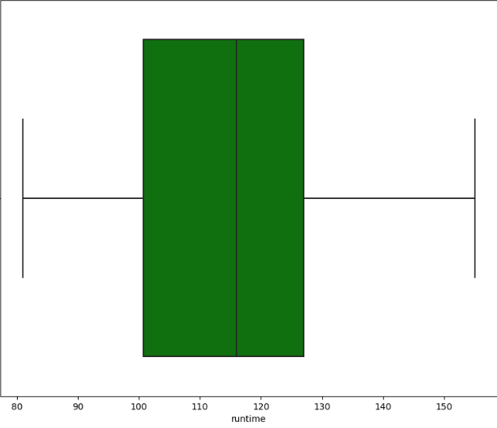
Top 500 Movies Wise Revenue.
Budget
Revenue
Runtime
Interpretation: The data of the top 500 movies has been summarized by calculating the central tendencies of ‘Budget’, ‘Revenue’, ‘Runtime’ . Outliers treatment has also been performed and the cleaned data is visualized using boxplot

Slide 12
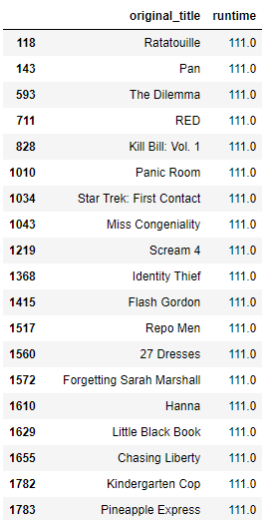
Movies Names Along With Their Run Times Equals To The Average Runtime
Interpretation: Movies like ‘Pan’, ‘RED’, ‘Scream 4’ etc have the average runtime 111

Slide 13
Conclusion
In line with our business objective, the analysis considered aspects like revenue, budget, and popularity in the cinema industry. Notably, 'Action', 'Adventure', 'Horror', 'Thrill', and 'Science Fiction' genres, despite their high budgets, tend to generate significant revenue. 'Avatar' stands out as the top-performing movie in the 'Action' genre.
Success stories like 'Titanic', 'Avengers', and 'The Dark Knight Rises' underscore the consistent appeal of certain genres. Interestingly, the analysis highlights that a high budget does not necessarily translate to popularity, indicating the need for a nuanced approach to predict commercial success.
These insights empower the company to focus on lucrative genres, improving predictions for a movie's potential success in the competitive cinema landscape.

Slide 14
THANKYOU

